Slide 1
Stock MARKET Prediction
by
AKSHAY RANCHOD PATIL
NAIPUNNYA RAJ
PAVAN KUMAR S V
SACHEET AMBLEKAR
VISHAL M

Slide 2
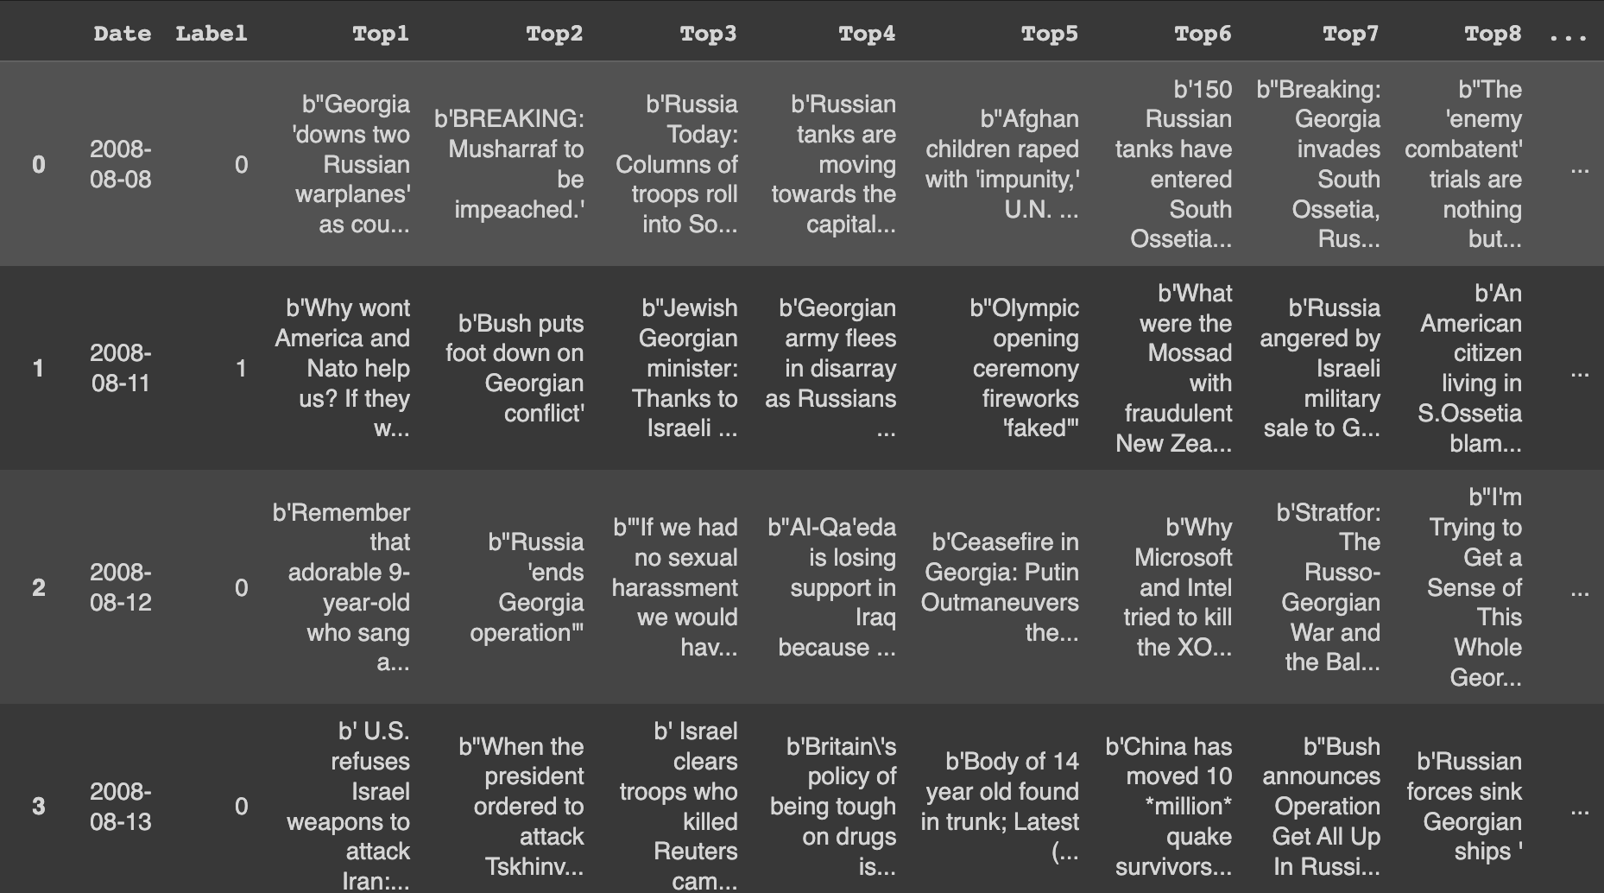
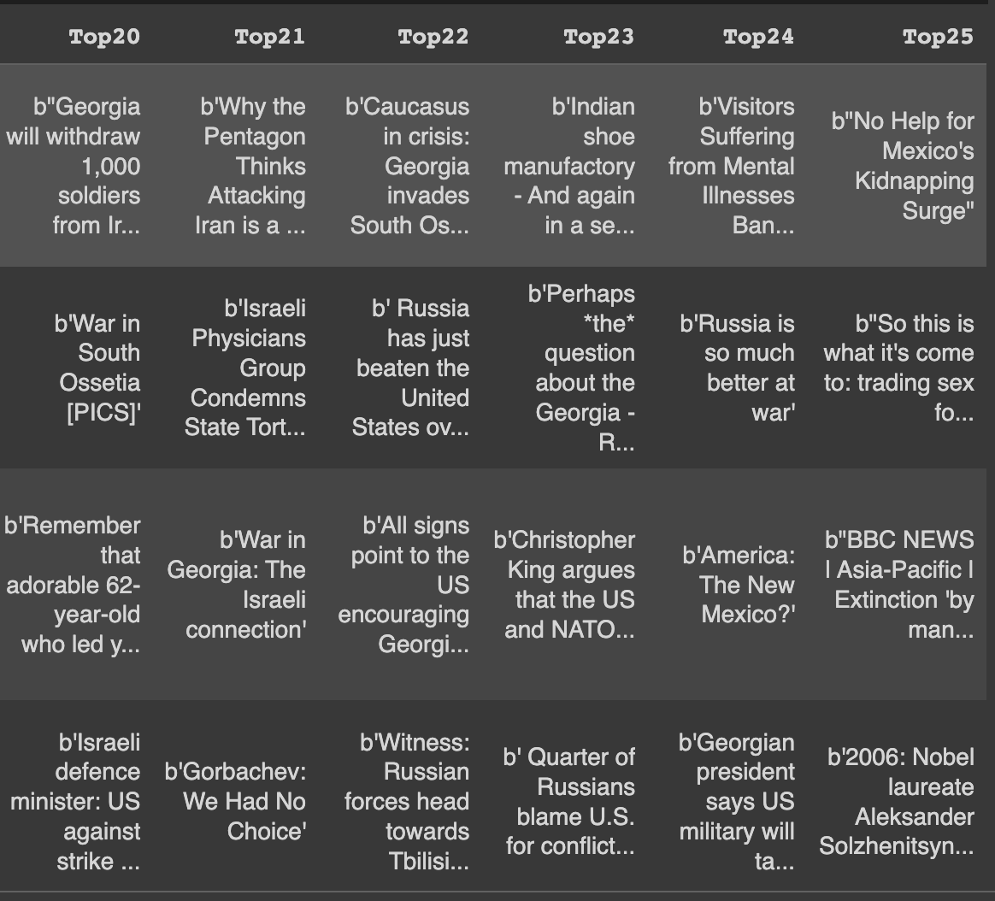
DATASET AND MOTIVATION
The Dataset contains the top 25 news headlines of a day.
Number of instances - 1989
Sentiment analysis must be done on this datasets to predict whether the stock price increases or decreases.

Slide 3
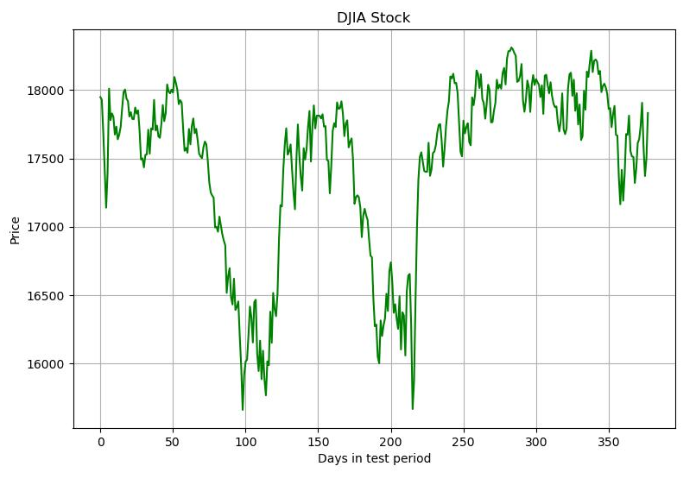
DATA PREPROCESSING
Ignored instances with missing features
Joined all the 25 headlines
Removed multi spaces, urls, hyphen, new lines etc.
Removed Stopwords
Stemming and Lemmatization
Train-Test Split

Slide 4
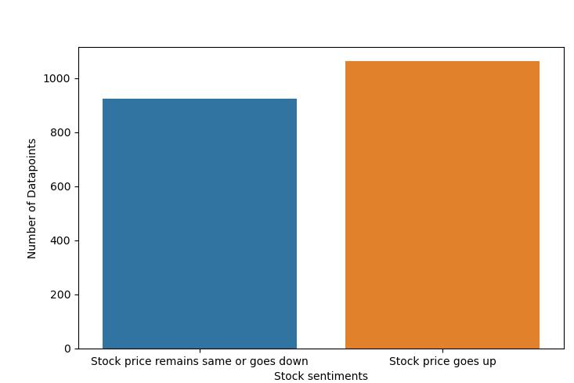
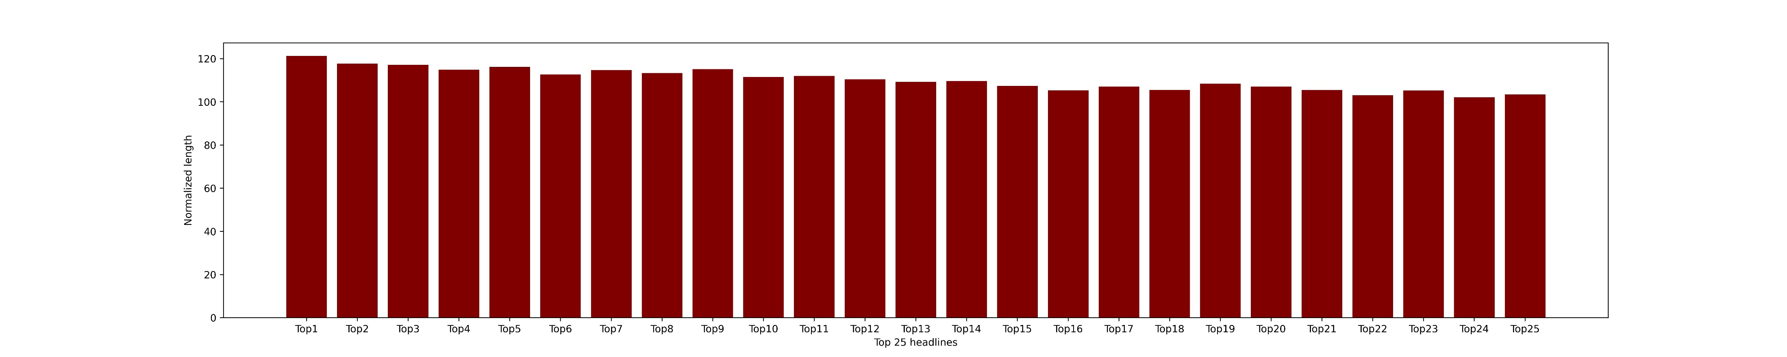
DATA Visualization
Data was prepared by taking the top 25 news (Reddit news) and the corresponding days opening and closing stock price.
The number of datapoints for each class is plotted to check for class imbalance.
Checking the lengths of the headlines to see whether any specific headline has more impact on the output labels

Slide 5
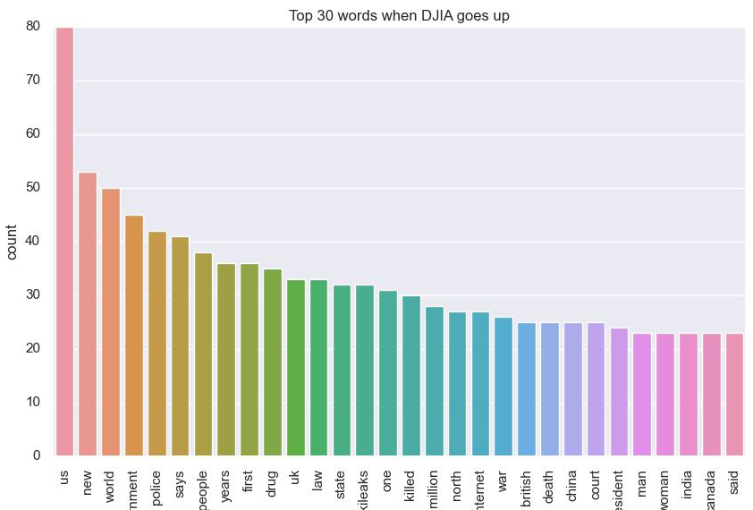
VECTORIZATION and stemming
Feature extraction was done by using the following two kinds of vectorizations:
TFIDF
Count vectorization
Then the data is pre-processed by using one of the following four approaches.
Stemming
Lemmatization
Stemming then Lemmatization
Lemmatization then Stemming

Slide 6
ML Models
K Nearest Neighbors:
k = 1
Cosine similarity
Decision tree:
max_depth = 75
max_features = default
Model | Accuracy
Count Vectorization (unigram) | 0.85
Count Vectorization (bigram) | 0.85
TfIdf Vectorization (unigram) | 0.83
TfIdf Vectorization (bigram) | 0.83
Model | Accuracy
Count Vectorization (unigram) | 0.79
Count Vectorization (bigram) | 0.67
TfIdf Vectorization (unigram) | 0.83
TfIdf Vectorization (bigram) | 0.71

Slide 7
Random Forest Classifier:
n_estimators = 200
criterion = entropy
max_depth = default
max_features = ‘auto’
Support Vector Machine:
C = default, 1
Model | Accuracy
Count Vectorization (unigram) | 0.84
Count Vectorization (bigram) | 0.85
TfIdf Vectorization (unigram) | 0.84
TfIdf Vectorization (bigram) | 0.83
Model | Accuracy
Count Vectorization (unigram) | 0.84
Count Vectorization (bigram) | 0.85
TfIdf Vectorization (unigram) | 0.85
TfIdf Vectorization (bigram) | 0.85

Slide 8
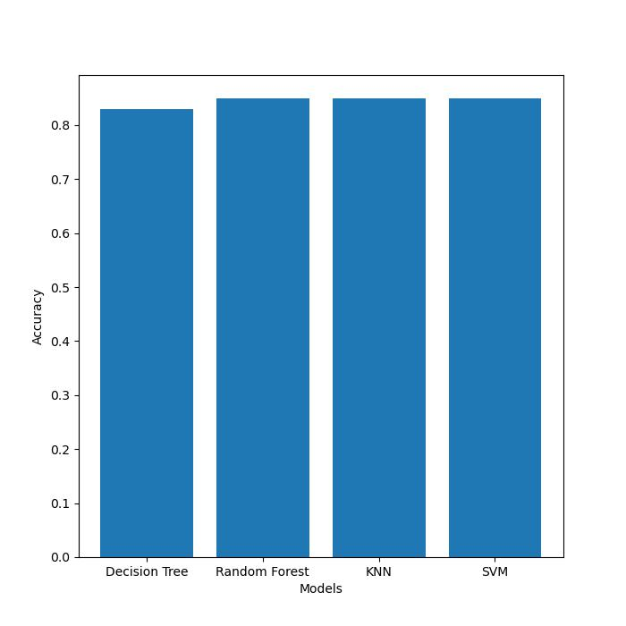
RESULTS
Model | Accuracy
KNN | 0.85
Decision Tree | 0.83
Random Forest | 0.85
SVM | 0.85

Slide 9
CONCLUSION
Sentiment analysis was carried out to make predictions and time-series data was not considered.
KNN classifier, Random Forest classifier and SVM classifier gave similar accuracy.
In Decision tree classifier, bigram models gave a lower accuracy
Count vectorization and TF-IDF vectorization had similar accuracies.

Slide 10
Contributions
AKSHAY RANCHHOD PATIL – Data Exploration and Preprocessing
NAIPUNNYA RAJ – Data Preprocessing and Visualization
PAVAN KUMAR S V – Data Visualization and ML models (Random forest and SVM)
SACHEET AMBLEKAR – Data Preprocessing and ML models (Random forest and Decision tree)
VISHAL M – Data Exploration and ML models (KNN)
BHARAT P

Slide 11
REFERENCE
DATASET : https://www.kaggle.com/datasets/aaron7sun/stocknews/download?datasetVersionNumber=2
Documentation: Python, Scikit learn, nltk

Slide 12
Thank you!

